Slide 1

DANIEL ESEME
SN/ 100841468
INTRODUCTION TO DATA ANALYSIS (DATA 1202)
FINAL PROJECT
PROF: SAM PLATI

Slide 2
RATIONAL STATEMENT
Mr. John Hughes needs a model to determine tumor, and has asked we develop three models (Support Vector Machine (SVM), Logistic Regression, and Decision Tree). This will help him accurately conduct patient diagnosis that will determine if they are Benign or Malignant tumor.
METHODOLOGY
We used three algorithms (SVM, Logistic Regression, and Decision Tree) to carry out the analysis. Based on the outputs, we will see which model is best for conducting, predicting and determining patients who have Benignant or Malignant tumor.

Slide 3
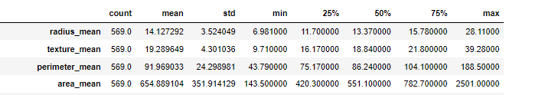
BASIC STATISTICS KEY INSIGHTS
The size (count) of our data is pretty good at 569.0, anything below sample size of 30 would have been a call for concern. Giving us a good sample size to build a model.
Secondly, looking at the spread (standard deviations) are well and visibly all over the place for each independent variable.
With regards to our quartiles (25%, 50%, 75%), there is not much of a similarity, rather the difference is clear, an increase is noticed at each percentile. Hence value count is not close
The range (minimum and maximum or min & max) for some of the variables is huge, spread, showing a significant difference.

Slide 4
BASIC STATISTICS KEY INSIGHTS (continuation)
Huge outliers as the spread is large
Looking at our central point (mean)
On average each independent variable when compared to the other gives up some points hence not really predicting well, looking at it from (radius_mean to area_mean). Each mean is larger than the previous.
The averages are rightly skewed from the max

Slide 5
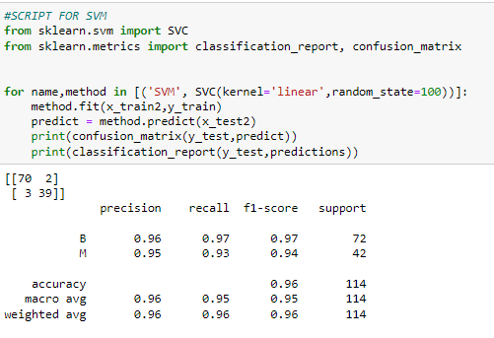
KEY INSIGHTS FROM ALGORITHMS
(SVM)
Top left output is confusion matrix , below it we have the classification report done together. It will be wrong to omit the former two as they help ensure correct calculations.
Support says it is a Large dataset of one hundred and fourteen(114), but more of one class (B) than another (M).
Very similar metrics
from a Precision point of view at 0.96, how precise it is at predicting patients who have benignant(B) or malignant(M) tumor. Precision does a very good job at 0.96
Recall at 0.96, how many times can it be predicted the patients are benignant(B) or malignant(M). So high at 0.96, a pretty good reoccurrence.
F1-Score at 0.96, is the weighted average of precision and f1-score which is still good
Since this is an imbalance dataset, I look at recall and f1-score which shows this is a pretty good model to use.
Top half, how good is it at predicting patients who have and do not have tumor. I will say very good at 0.96 for B and 0.95 for M. Should I implement this model for predicting and not predicting tumor? Yes, it should be used for getting both results.

Slide 6
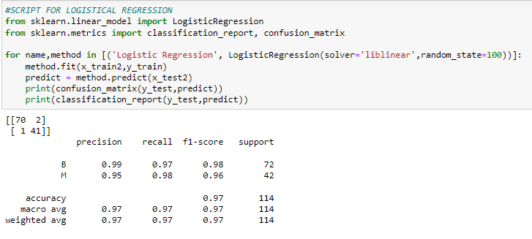
KEY INSIGHTS FROM ALGORITHMS
(LOGISTICAL REGRESSION)
Top left output is confusion matrix , below it we have the classification report done together. It will be wrong to omit the former two as they help ensure correct calculations.
Support says it is a Large dataset of one hundred and fourteen(114), but more of one class (B) than another (M).
Same metrics
from a Precision point of view at 0.97, how precise it is at predicting patients who have benignant(B) or malignant(M) tumor. Very precise at 0.97 without a doubt.
Recall at 0.97, how many times can it be predicted the patients are benignant(B) or malignant(M). So high at 0.97, a very good reoccurrence.
F1-Score at 0.97, is the weighted average of precision and f1-score which is good.
Since this is an imbalance dataset, I will look at recall and f1-score which shows this is highly a good model to use.
Going by both classes (M & B), how good is it at predicting patients who have and do not have tumor. This model is very good at 0.99 for B and 0.95 for M. Should I implement this model for predicting and not predicting tumor? Yes, it should be used for getting both results, especially for B which is almost 100% certain.

Slide 7
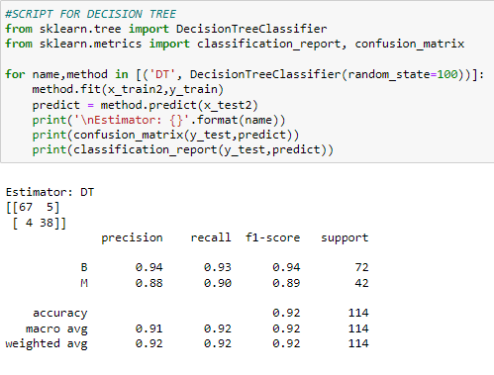
KEY INSIGHTS FROM ALGORITHMS
(DECISION TREE)
Top left output is confusion matrix , below it we have the classification report done together. It will be wrong to omit the former two as they help ensure correct calculations.
Support says it is a Large dataset of one hundred and fourteen(114), but more of one class (B) than another (M).
Similar metrics
Looking at Precision with 0.92, how precise it is at predicting patients who have benignant(B) or malignant(M) tumor. Precision does a very precise prediction at 0.92.
Recall at 0.92, that is if the patients want the test redone, how many times can it be predicted the patients are benignant(B) or malignant(M). So high at 0.92, a pretty good reoccurrence.
F1-Score at 0.92, is the weighted average of precision and f1-score which is still a good prediction.
Since this is an imbalance dataset, I look at recall and f1-score which shows this is a pretty good model to use.
With both tumors, how good is it at predicting both benignant and Malignant. I will say good at 0.94 for B and 0.88 for M. Should I implement this model for predicting and not predicting tumor? Yes, it should be used for getting both results, but better for predicting B.

Slide 8
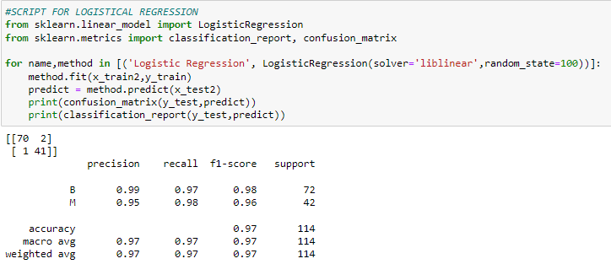
MODEL RECOMMENDATION
The logistic algorithm to me did a pretty good job with the dataset. I will recommend this model for it’s;
Accuracy
Weighted average
Predictability
Recall and f1-score
When compared with support vector machine (SVM), the logistical regression algorithm is more accurate and precise for both B and M.

Slide 9
POSSIBLE IMPROVEMENTS FOR LOGISTIC MODEL
Take a proper look at the independent variables to assure they are the right variables. Is it possible to use other variables
Find a way to balance the dataset, since it’s an imbalance dataset

